Slide 1
Chapter One Data Structures and Libraries
Linear DS with Built-in Libraries
Non-Linear DS with Built-in Libraries
Data Structures with Our Own Libraries

Slide 2
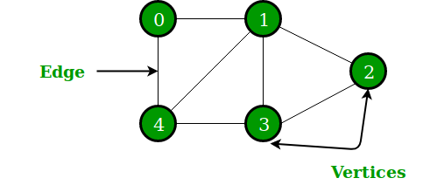
Data Structures with Our Own Libraries
1. Graph representation
A graph consists of nodes and edges. In this book, the variable n denotes the number of nodes in a graph, and the variable m denotes the number of edges.
The nodes are numbered using integers 0,1, 2, . . . , n-1.
For example n = 5.
A path leads from node a to node b through edges of the graph. The length of a path is the number of edges in it. path: 0 -> 1 -> 4 -> 3, length = 3
A path is a cycle, if the first and last node is the same. 1 -> 3 -> 4 -> 1
A graph is connected if there is a path between any two nodes.
Two nodes are neighbors or adjacent if there is an edge between them. Example: 0 and 1, 3 and 4
The degree of a node is the number of its neighbors. deg(0) = 2, deg(1) = 4, deg(2) = 2.

Slide 3
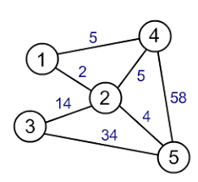
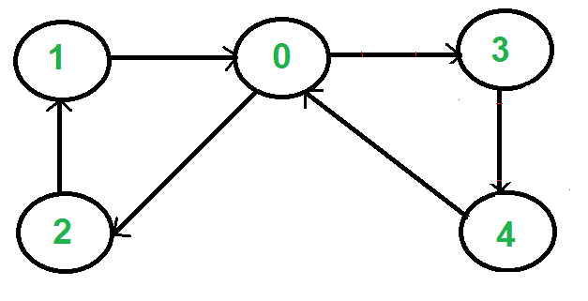
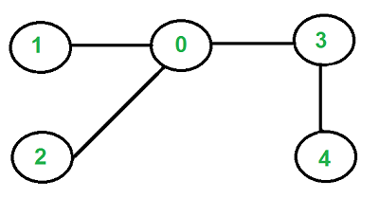
Data Structures with Our Own Libraries
A graph is directed, if the edges can be traversed in one direction only.
In a weighted graph, each edge is assigned a weight.
A tree is a connected graph that consists of n nodes and n − 1 edges, and there is a unique path between any two nodes of a tree.

Slide 4
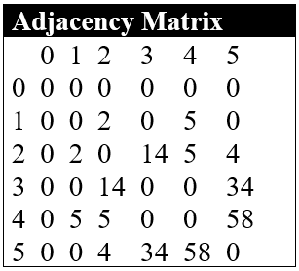
Graph representation
Adjacency matrix representation
An adjacency matrix is a two-dimensional.
We can efficiently check from an adjacency matrix if there
is an edge between two nodes. The matrix can be stored as an array like adj[N+1][N+1];
where each value adj [ a ][ b ] indicates whether the graph contains an edge from node a to node b . If the edge is included in the graph, then adj [ a ][ b ] = 1, and otherwise adj [ a ][ b ] = 0.
If the graph is weighted, the adjacency matrix representation can be extended so that the matrix contains the weight of the edge if the edge exists.
The space complexity of Adjacency List is O(V * V).

Slide 5
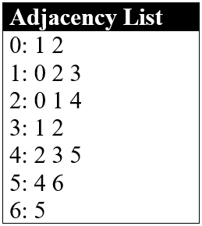
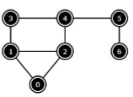
Graph representation
Adjacency list representation
In the adjacency list representation, each node x in the graph is assigned an
adjacency list that consists of nodes to which there is an edge from x.
Adjacency lists are the most popular way to represent graphs, and most algorithms can be efficiently implemented using them.
The space complexity of Adjacency List is O(V + E).

Slide 6
Adjacency list representation
A convenient way to store the adjacency lists is to declare an array of vectors as follows:
vector<int> adj[N];
The constant N is chosen so that all adjacency lists can be stored.
adj[1].push_back(2);
If the graph is undirected, it can be stored in a similar way, but each edge is added in both directions.
adj[1].push_back(2); adj[2].push_back(1);
For a weighted graph, the structure can be extended as follows:
vector<pair<int,int>> adj[N];
In this case, the adjacency list of node a contains the pair ( b, w ) always when there is an edge from node a to node b with weight w .
adj[1].push_back({2,5});
adj[2].push_back({3,7});
adj[2].push_back({4,6});

Slide 7
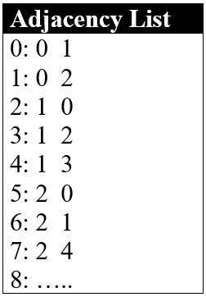
Graph representation
Edge list representation
An edge list contains all edges of a graph in some order.
This is a convenient way to represent a graph if the algorithm processes all
edges of the graph and itis not needed to find edges that start at a given node.
The space complexity is clearly O(E).
This graph representation is very useful for Kruskal’s algorithm
for MST, where the collection of undirected edges need to be
sorted by ascending weight

Slide 8
Edge list representation
The edge list can be stored in a vector
vector<pair<int,int>> edges;
where each pair ( a, b ) denotes that there is an edge from node a to node b .
edges.push_back({1,2});
edges.push_back({2,3});
edges.push_back({2,4});
If the graph is weighted, the structure can be extended as follows:
vector<tuple<int,int,int>> edges;
Each element in this list is of the form ( a, b, w ), which means that there is an edge from node a to node b with weight w .
edges.push_back({1,2,5});
edges.push_back({2,3,7});

Slide 9
Disjoint Set (Or Union-Find)
2. Disjoint Set (Or Union-Find)
The Union-Find Disjoint Set (UFDS) is a data structure to model a collection of disjoint sets with the ability to eﬃciently determine whether two items belong to the same set and to unite two disjoint sets into one larger set.
A disjoint-set data structure is a data structure that keeps track of a set of elements partitioned into a number of disjoint (non overlapping) subsets.
A union-find algorithm is an algorithm that performs two useful operations on such a data structure:
Find: Determine which subset a particular element is in. This can be used for determining if two elements are in the same subset.
Union: Join two subsets into a single subset.

Slide 10
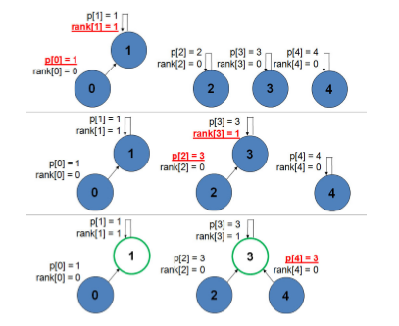
Disjoint Set (Or Union-Find)
unionSet(0, 1) sets p[0] to 1 and rank[1] to 1.
unionSet(2, 3) sets p[2] to 3 and rank[3] to 1.
unionSet(3, 4) sets p[4] to 3.

Slide 11
Disjoint Set (Or Union-Find)
Our C++ implementation is shown below:
vector<int> p(N), rank(N); for (int i = 0; i < N; i++) p[i] = i; }
int findSet(int i) { return (p[i] == i) ? i : (p[i] = findSet(p[i])); }
bool isSameSet(int i, int j) { return findSet(i) == findSet(j); }
void unionSet(int i, int j) {
if (!isSameSet(i, j)) { // if from different set
int x = findSet(i), y = findSet(j);
if (rank[x] > rank[y]) p[y] = x; // rank keeps the tree short
else {
p[x] = y;
if (rank[x] == rank[y]) rank[y]++;
}
}
}

Slide 12

Segment Tree
3. Segment Tree
The Segment Tree (or Tree intervals) is a data structure that allows us to store information in the form of intervals, or segments.
It can be used for making construct or update or query operations upon array intervals in logarithmical time.
Segment tree for the interval [i, j] in the following manner:-
The first node will hold the information for the interval [i, j]. If i<j the left and right son will hold the information for the intervals [i, (i+j)/2] and [(i+j)/2+1, j].
Operations of Segment Tree
Construct tree: To init the tree segments or intervals values.
Update tree: To update value of an interval or segment.
Query tree: To retrieve the value of an interval or segment.
This is more commonly known as the Range Minimum Query (RMQ) problem.
For example, given an array A of size n = 7 below, RMQ(1, 3) = 2, as the index 2 contains the minimum element among A[1], A[2], and A[3].
To check your understanding of RMQ, verify that in the array A below, RMQ(3, 4) =4 , RMQ(0, 0) = 0, RMQ(0, 1) = 1, andRMQ(0, 6) = 5. For the next few paragraphs, assume that array A is the same.

Slide 13
Segment Tree
Since a Segment Tree is a binary tree, a simple linear array can be used to represent the Segment Tree.
A Segment Tree can be built using recursion (bottom-up approach ).
Start with the leaves and go up to the root and update the corresponding changes in the nodes that are in the path from leaves to root.
Leaves represent a single element.
In each step, the data of two children nodes are used to form an internal parent node.
Each internal node will represent a union of its children’s intervals.
Merging may be different for different questions. So, recursion will end up at the root node which will represent the whole array.

Slide 14
Segment Tree
Implementation:
void build(int node, int start, int end){
if(start == end) {
tree[node] = A[start]; // Leaf node will have a single element
}
else {
int mid = (start + end) / 2;
build(2*node, start, mid); // Recurse on the left child
build(2*node+1, mid+1, end); // Recurse on the right child
// Internal node will have the sum of both of its children
tree[node] = tree[2*node] + tree[2*node+1];
}
}

Slide 15
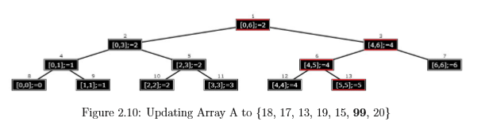
Segment Tree
For update(), search the leaf that contains the element to update.
This can be done by going to either on the left child or the right child depending on the interval which contains the element.
Once the leaf is found, it is updated and again use the bottom-up approach to update the corresponding change in the path from that leaf to the root.

Slide 16
Segment Tree
For update(), search the leaf that contains the element to update.
This can be done by going to either on the left child or the right child depending on the interval which contains the element.
Once the leaf is found, it is updated and again use the bottom-up approach to update the corresponding change in the path from that leaf to the root.
void update(int node, int start, int end, int idx, int val){
if(start == end)
{ A[idx] += val; // Leaf node
tree[node] += val;
}
else {
int mid = (start + end) / 2;
if(start <= idx and idx <= mid)
update(2*node, start, mid, idx, val);
else
update(2*node+1, mid+1, end, idx, val);
tree[node] = tree[2*node] + tree[2*node+1]; children}
}

Slide 17
Segment Tree
To make a query() on the Segment Tree, select a range from L to R (which is usually given in the question).
Recurse on the tree starting from the root and check if the interval represented by the node is completely in the range from L to R.
If the interval represented by a node is completely in the range from L to R, return that node’s value.
int query(int node, int start, int end, int l, int r){
if(r < start or end < l)
return 0; // range represented by a node is completely outside the given range
if(l <= start and end <= r)
return tree[node]; // range represented by a node is completely inside the given range
int mid = (start + end) / 2; // range represented by a node is partially inside and
int p1 = query(2*node, start, mid, l, r);
int p2 = query(2*node+1, mid+1, end, l, r);
return (p1 + p2);
}

